Slide 2
Data Science doesn’t just happen…
It takes a Process
Dr. Jacob Spoelstra
Dr. Hang Zhang
Gopi Kumar
Data Science Team @ Microsoft

Slide 3
Three major trends are converging…
…ushering in the Fourth Industrial Revolution
Big Data & IoT
Cloud
Intelligence

Slide 4
The opportunity is bigger than you may think
Diverse
data
$1.6T
New
@
How?
analytics
speed
data dividend available to businesses that embrace data over the next four years
More
people
Data source: Microsoft and IDC, April 2014

Slide 5
Traditional Applications
Intelligent Applications
Program logic based on static rules
Actions are pre-defined
Limited adaptation to change in patterns of data
Learns from data, makes predictions and improves with experience
Leverages Cloud-Hosted APIs
Examples: Recommendations, Predictive Maintenance, Churn detection, CRM: Lead scoring

Slide 6
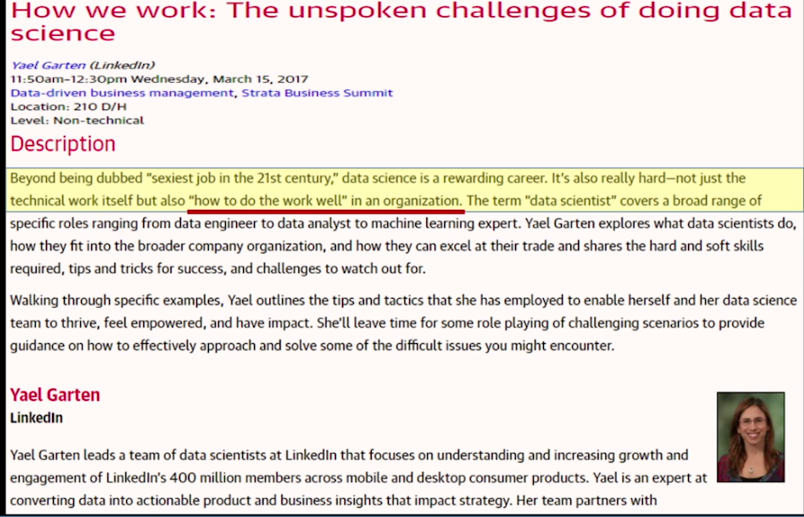
Sobering statistics
“Only 27% of the big data projects are regarded as successful”
Only 13% of organizations have achieved full-scale production for their Big Data implementations
“Only 8% of the big data projects are regarded as VERY successful”
“Only 17% of survey respondents said they had a well-developed Predictive/Prescriptive Analytics program in place, while 80% said they planned on implementing such a program within five years” – Dataversity 2015 Survey
Source: CapGemini 2014
Notes:
Aim to help enterprises be more productive in their data science projects
Strata San Jose

Slide 7
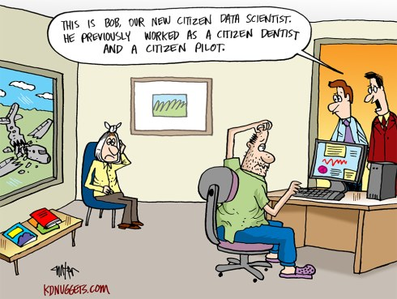
Notes:
In the spirit of election season, (TRUMP)
Data Science is gonna be HUGE,
we’re gonna make it great again

Slide 8
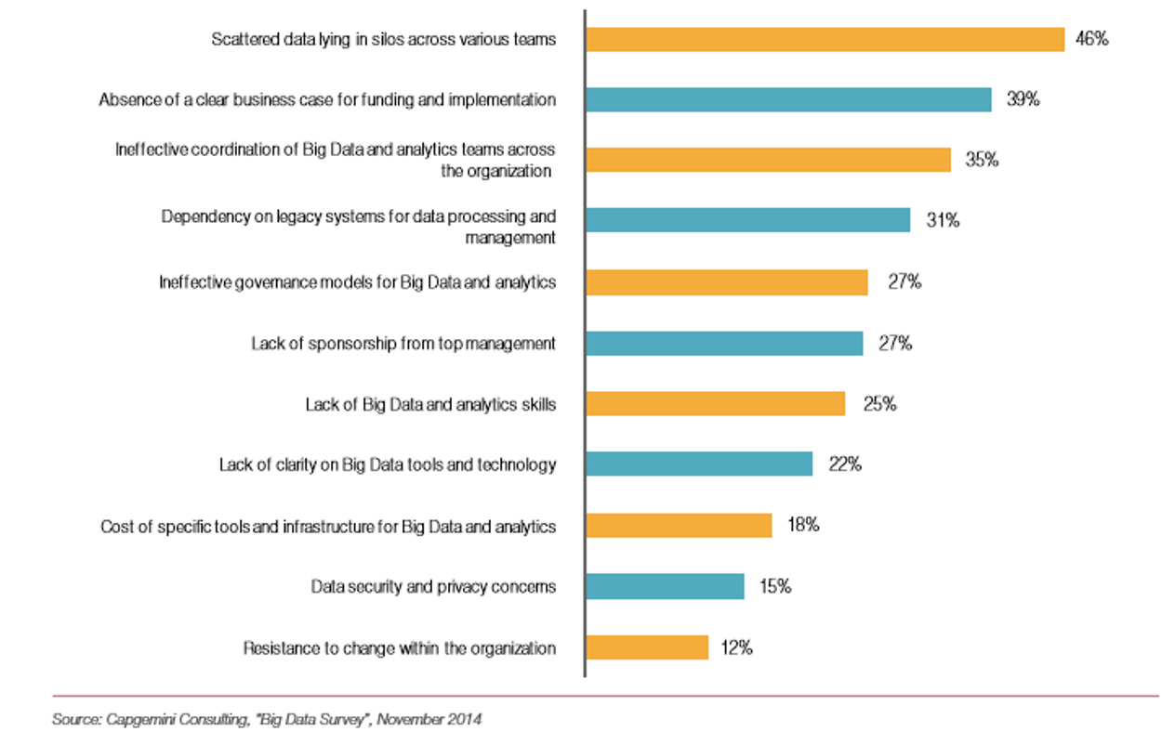
Challenges

Slide 9
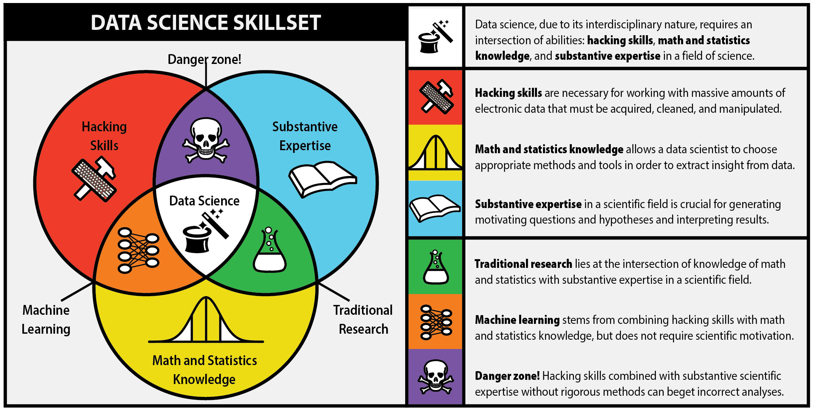
Courtesy: Steve Geringer. http://www.anlytcs.com/2014/01/data-science-venn-diagram-v20.html
Source: http://berkeleysciencereview.com/how-to-become-a-data-scientist-before-you-graduate/
Notes:
Data science is where ML meets real world

Slide 10
How to Do the Work Well in an Organization
We need a Standardized data science process
For data scientists, a standardized data science process can:
Support collaboration
Support quality assurance in the entire lifecycle of a project
Support security control of project assets
Support better planning and tracking
For organization, a standardized data science process can:
Provide convenience for management to plan and track
Accumulate knowledge and expertise over time to continuously improve productivity

Slide 11
Addressing the Challenges at Microsoft

Slide 12
What Problems are we Solving?
Global teams
Five geographic locations
New Teams
Different backgrounds
Varied clients
Both external and internal
Quality
Organization
Collaboration
Knowledge Accumulation:
Agility
Consistent, repeatable steps. Required artifacts.
keeping track of artifacts in distributed cloud environments
Across teams, resources
Effective sharing, preventing reinvention of wheels
Get going fast, execute efficiently.
Notes:
mSFT has 6 global teams, different backgrounds, skillsets, ways of working → to deliver a product
Data scientists don’t create the same pipelines over & over again
Quality: Its all about Quality & consistency in building the product
Knowledge Accumulation – send me code in email or send me the presentation you did

Slide 13
What is a Process?
A process specifies a detailed sequence of activities necessary to perform specific business tasks.
It is used to standardize procedures and establish best practices.
Notes:
Edward Deming:
If you can’t describe what you’re doing as a process,
you don’t know what you’re doing

Slide 14
Data Science != Software Engineering But, we can learn a lot especially on processes
Notes:
Version control for your work

Slide 15
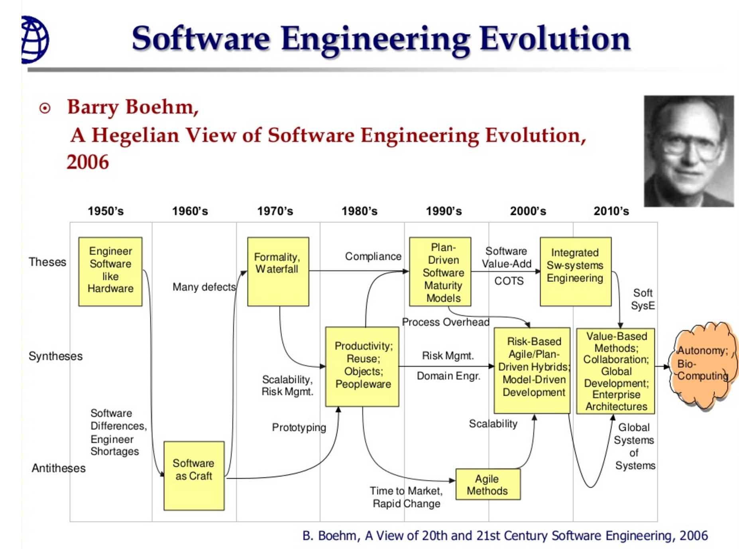
Evolution of Software Development Process

Slide 16
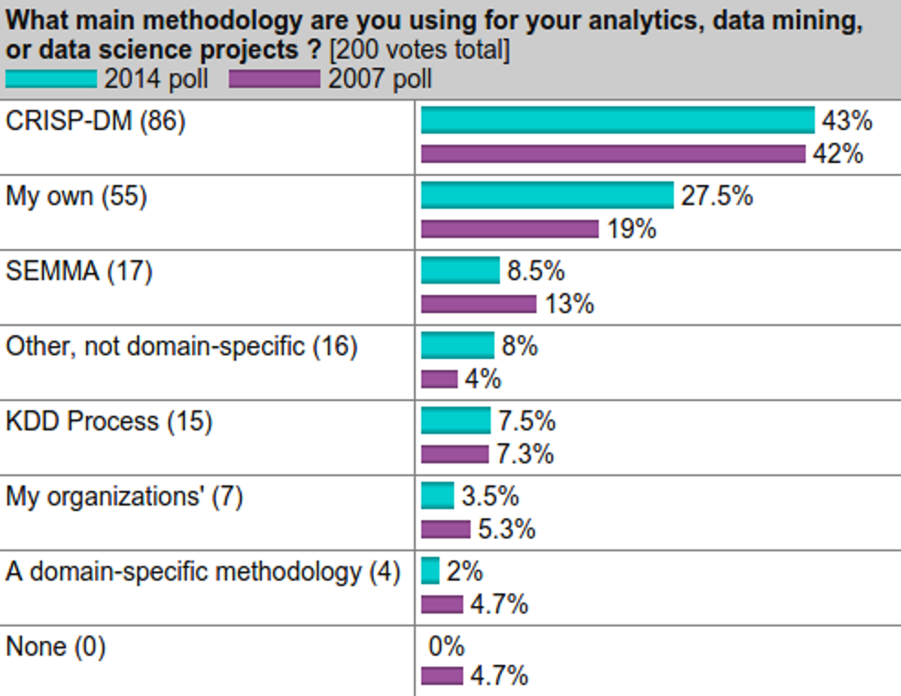
Who uses a Process for Data Science?
Source: KDD Nuggets, October 2014
Notes:
Python has over taken R

Slide 17
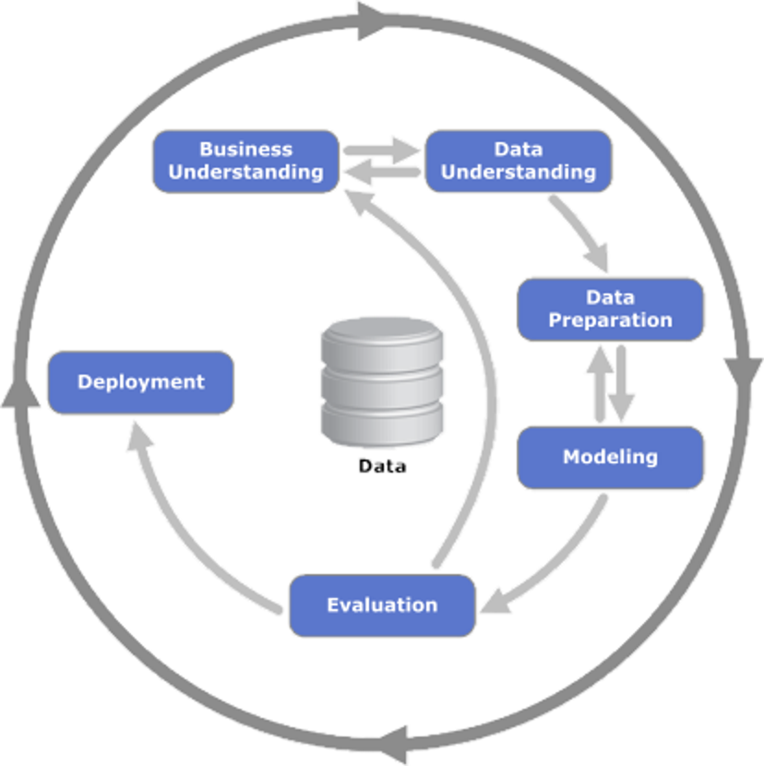
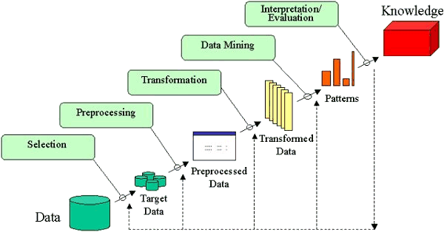
Methodologies
Cross-Industry Standard Process for Data Mining
(CRISP-DM)
Knowledge Discovery in Databases
(KDD)
Notes:
Describes lifecycle of a data science project
Highlights:
Iterative
Hard to argue against it, on a high level this is what you do
But what should I do & produce in this process?

Slide 18
Pillars of Data Science Process
Standard Project Lifecycle
Standardized Document Templates, Project Structure
Shared, Distributed Resources
Productivity Tools, Shared Utilities
Notes:
Resources – DSVM

Slide 19
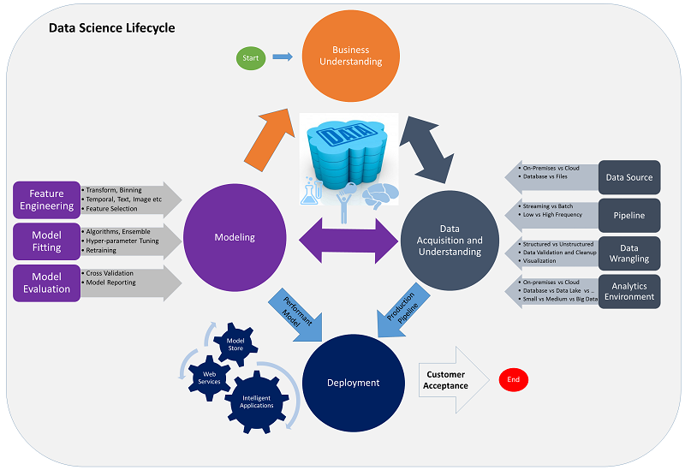
Notes:
So lets go through each component of the process in the previous slide
1) Lifecycle
This is TDSP. Not different from CRISP-DM, but a lot more detailed.

Slide 20
Data Science Project Lifecycle
Business Understanding
Data Acquisition, Understanding
Modeling
Deployment
Acceptance
Scoping
Provision Resources
Ingest
Exploration
Feature Engineering
Model Development
Evaluation
Model
Production Pipeline
Monitor
Finalize Documents
Free Resources
Charter
Handoff

Slide 21
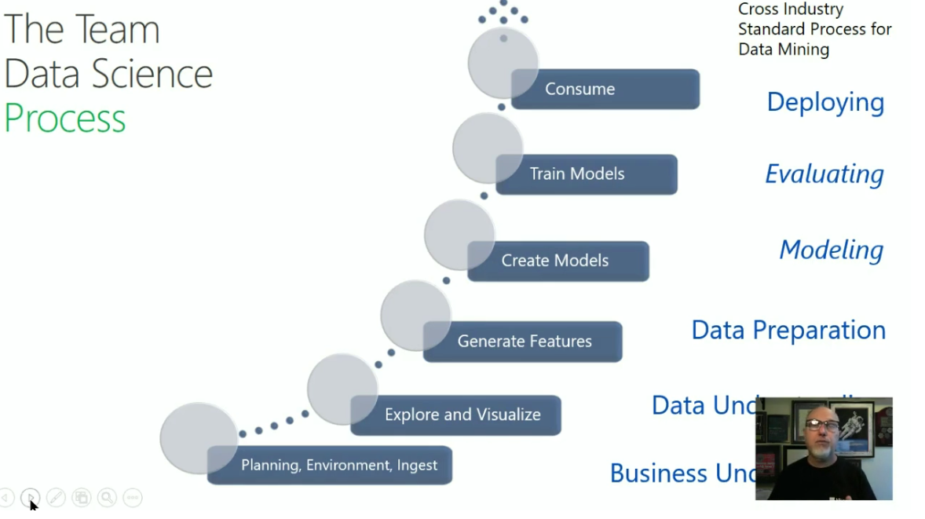
The Team Data Science Process
Business Understanding
Define Objectives
Identify Data Sources
Data Acquisition and Understanding
Ingest Data
Explore Data
Modeling
Feature Selection
Create and Train Model
Deployment
Customer Acceptance
Operationalize
Testing and Validation
Update Data
Handoff
Re-train and re-score
Notes:
Data Science Blog: https://buckwoody.wordpress.com/

Slide 22
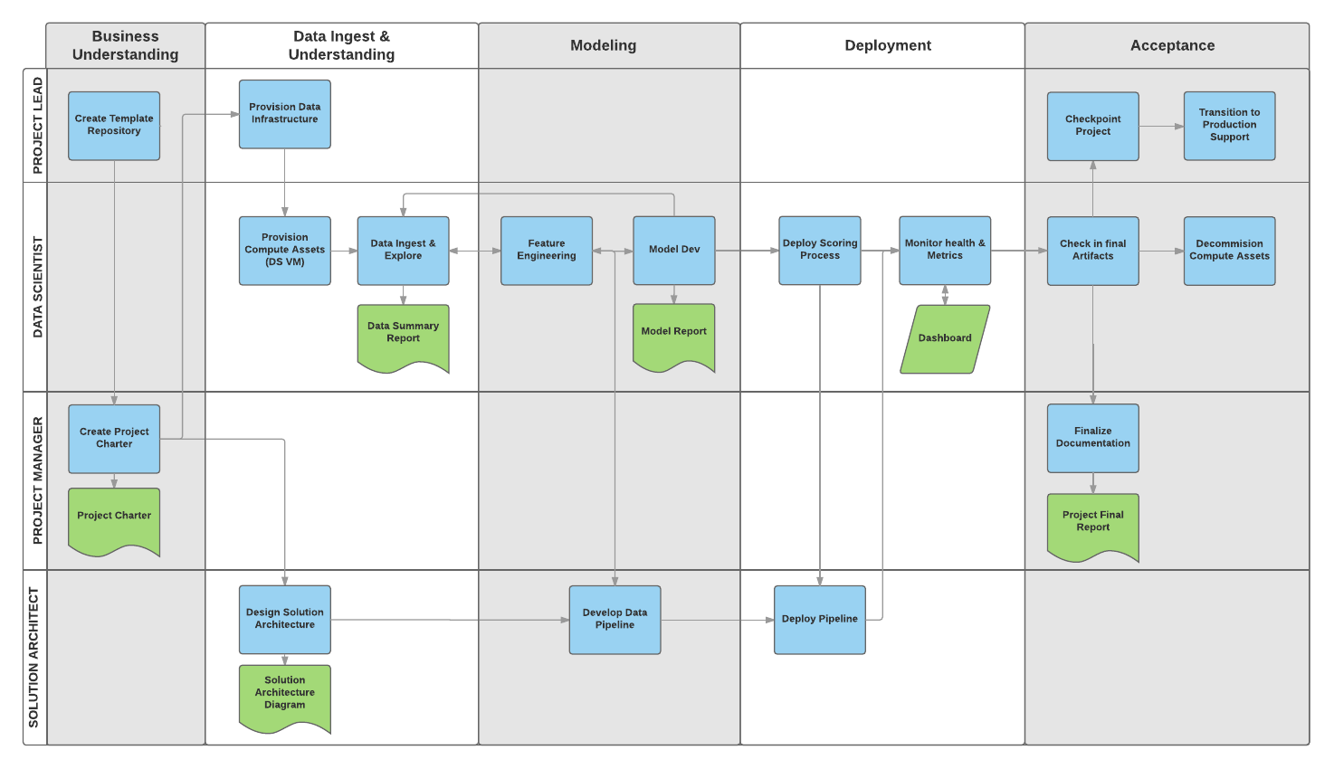
Notes:
Swim lanes
Blue tasks
Green artifacts produced

Slide 23
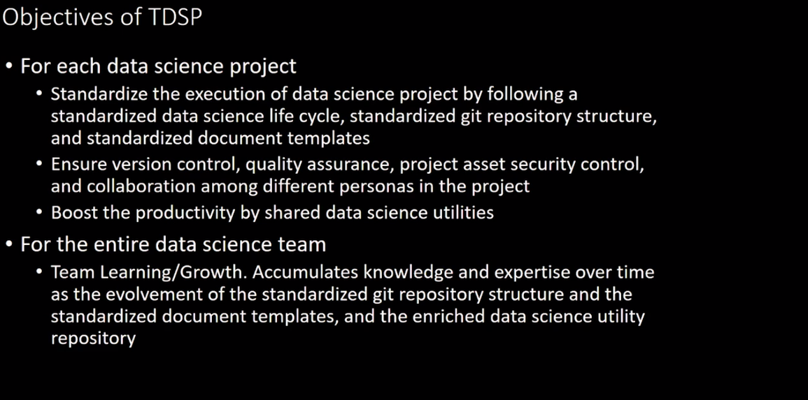

Slide 24
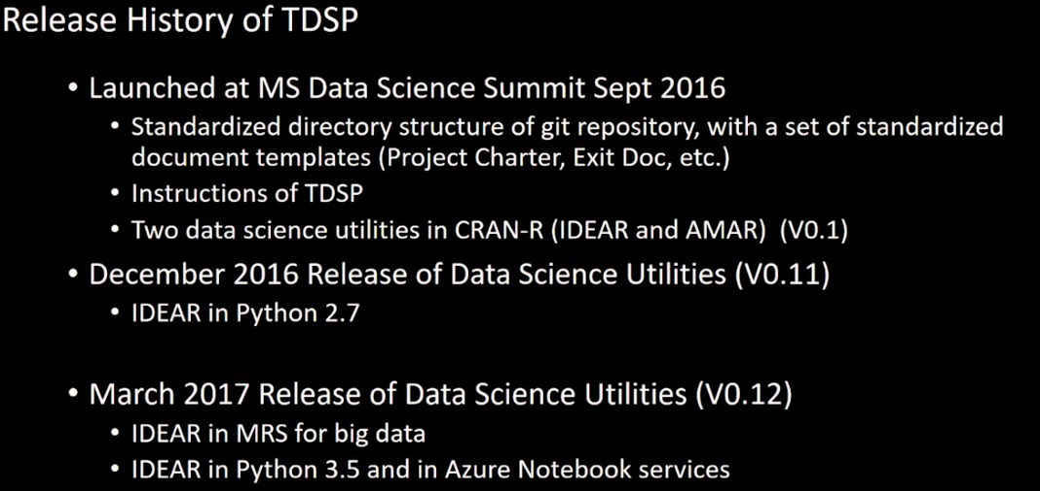
Notes:
Interactive Data Exploration, Analysis, and Reporting (IDEAR)

Slide 25
Project Template – Charter Data Report

Slide 26
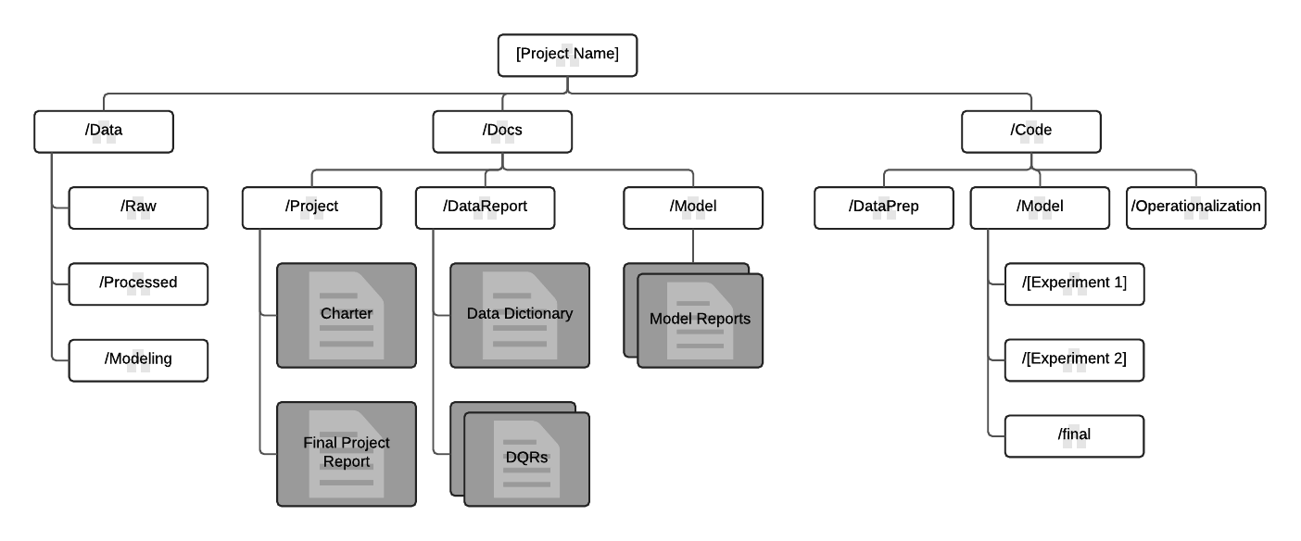
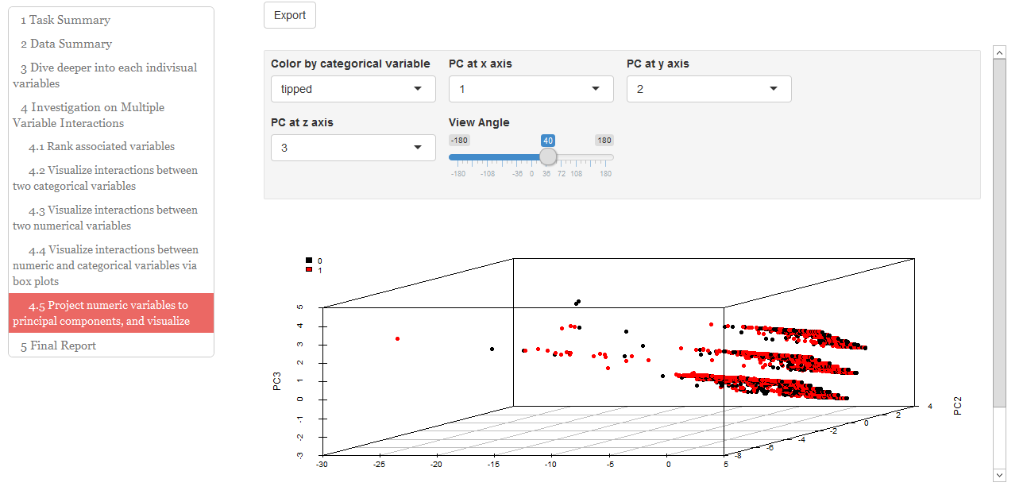
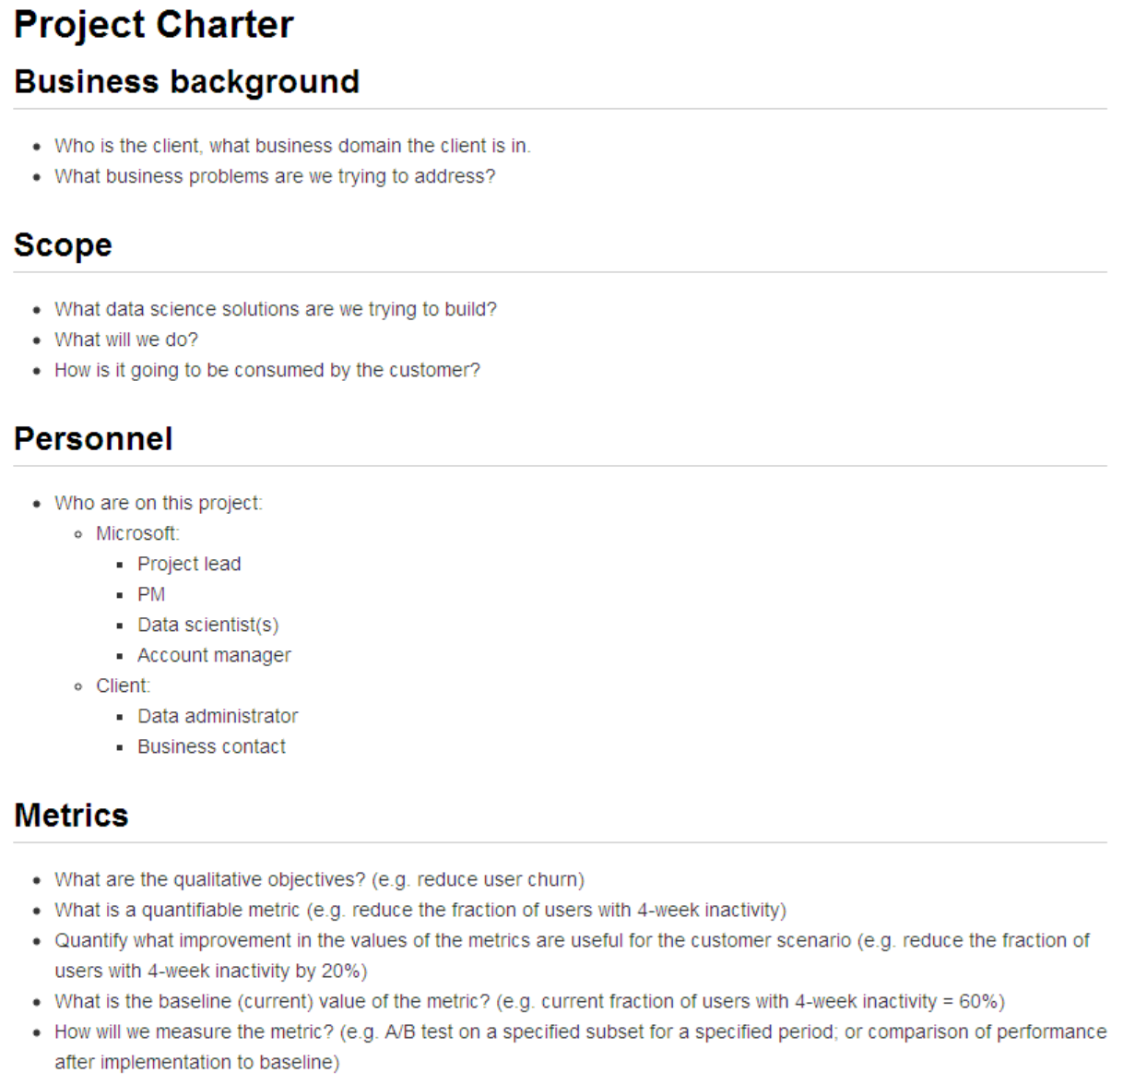
Standardized Artifacts, Shared Productivity Utilities
Templates
Utilities
Notes:
2) Templates
Nobody these days starts with a blank screen
We provide you templates – checklist questions

Slide 27
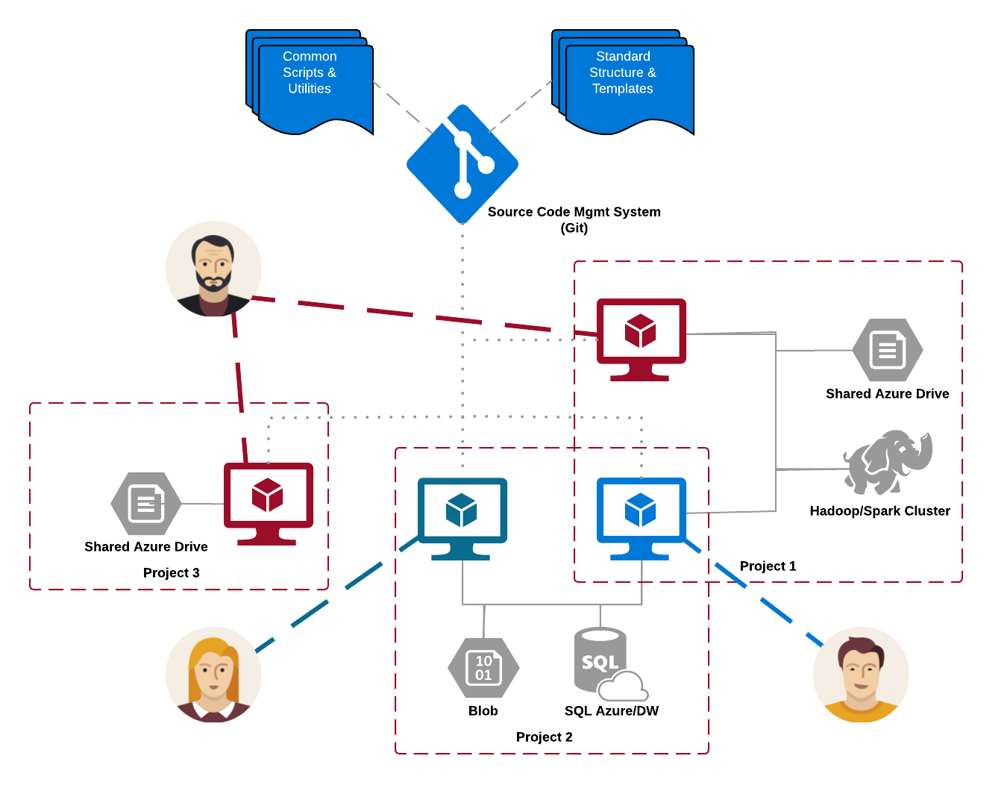
Shared and Distributed Infrastructure
Notes:
Main artifacts sit in a Git repository & templates, and track work items.
We provide utilities for you to check in your code

Slide 28


Documented Practices – Measure and Refine
Efficiency
Project 6
Project 5
Project 4
Project 4
Project 3
Project 3
Project 2
Project 2
Project 1
Project 1
Project
Notes:
We have started to see improve our metrics - time

Slide 29
Who is this for?
Data Science TEAM
Manager
Individual Contributor
Organization: code, artifacts
Standardization
Versioning
Knowledge Accretion
Security: role-based access control
Productivity: utilities, sharing, templates
Collaboration: distributed compute, no contending for resources.

Slide 30

Team Data Science Process at Microsoft
Data science virtual machines (DSVMs) as the development platform on cloud
Use Visual Studio Team Services (VSTS)
work item tracking and scrum planning
Git repositories
Share utilities in Git repository to make different steps of a data science process more efficient
Use cloud-based Azure resources as needed
Notes:
Included in DSVM:
MRS
Azcopy
Save on setup time, mitigate compatibility issues, on/off board, everythink is checked into git so no need to recycle VM so saves you budget

Slide 31
Data science virtual machines (DSVM) on Azure
DSVM (Windows and Linux) by default comes with useful tools for data science
Save your time on setting up
DSVM can be a shared resource for the team
DSVM can be a central hub for other Azure resources

Slide 32
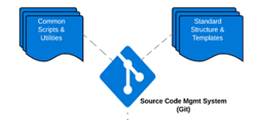
Visual Studio Team Services
Visual Studio Team Services (VSTS) is a cloud-based solution for:
Work item management and sprint planning, AND
Source code management system through Git repositories
Project repository: a standard directory structure and a set of standardized documents
Each data science project has an individual project repository to ensure security
Utilities repository: a set of useful data science tools to make data scientists more productive
Facilitates collaboration, security policies and versioning

Slide 33
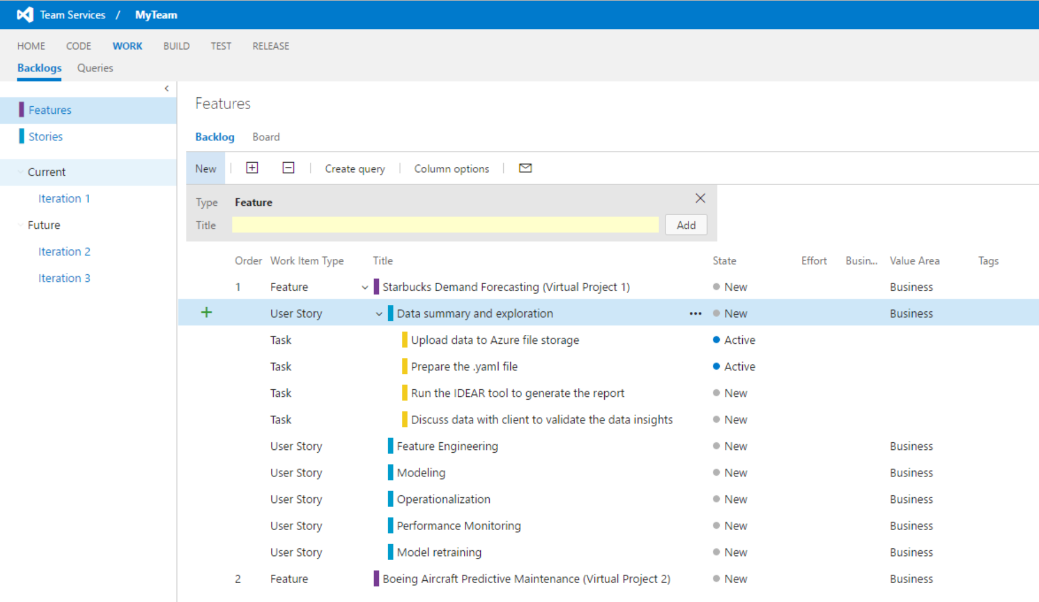
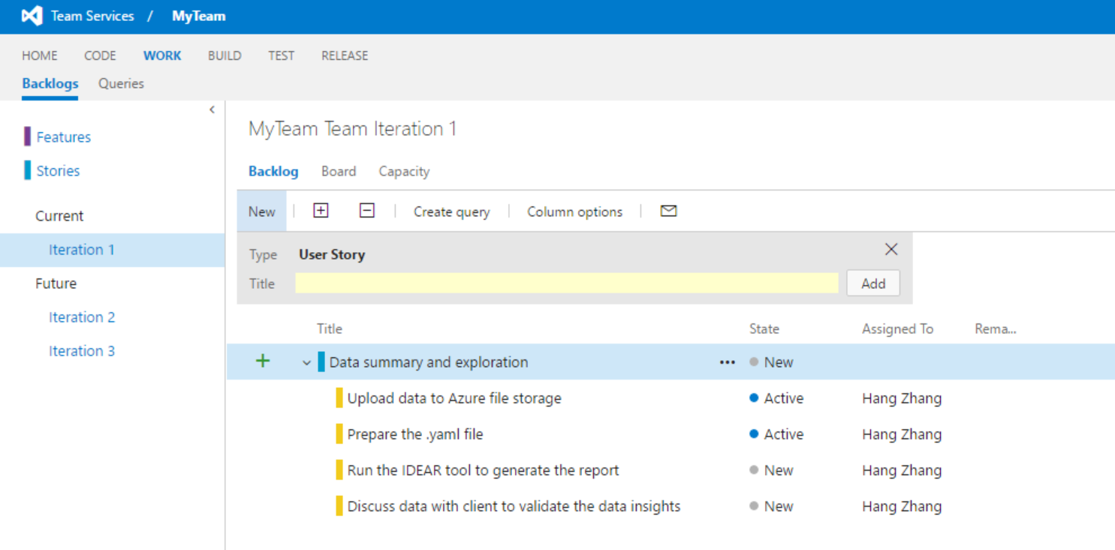
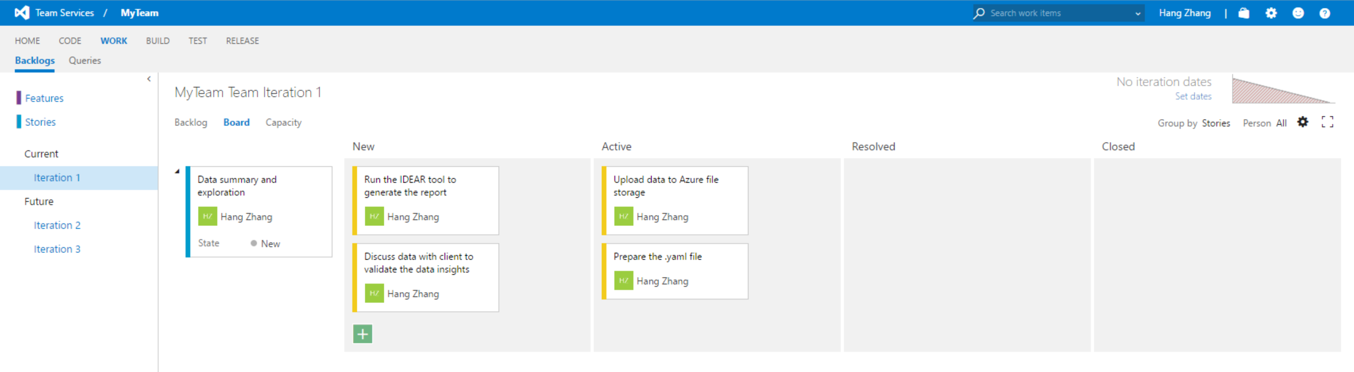
Workitem tracking and agile planning
Terminology:
Feature: a project
Story: a stage in the E2E process of a DS project
Tasks: specific coding/documentation/other activities that are needed to complete a story
Iteration: usually a 2-week sprint

Slide 34
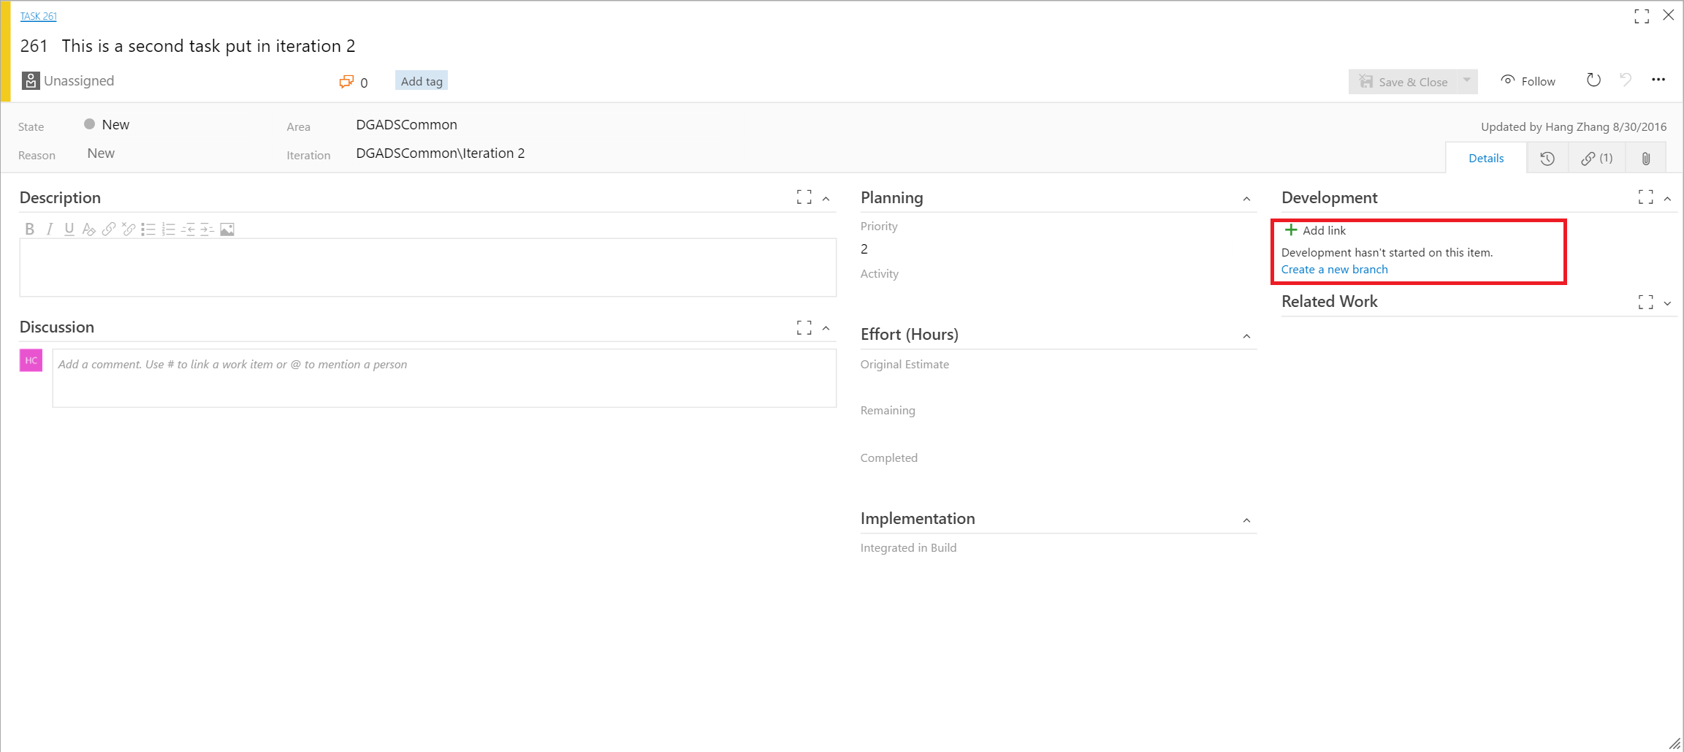
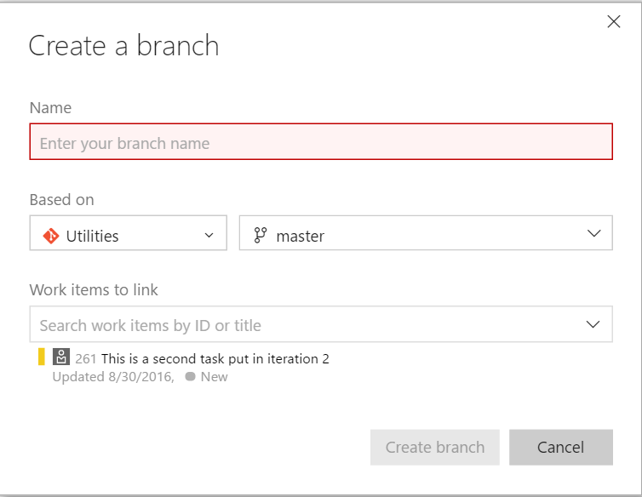
Link work items with Git branches
Usually work items and versioning are managed by two independent systems
VSTS allows a workitem to be connected with a git branch so works done in the git branch can be tracked by the workitem
Enables us to understand what have been done to resolve/close a work item.

Slide 35
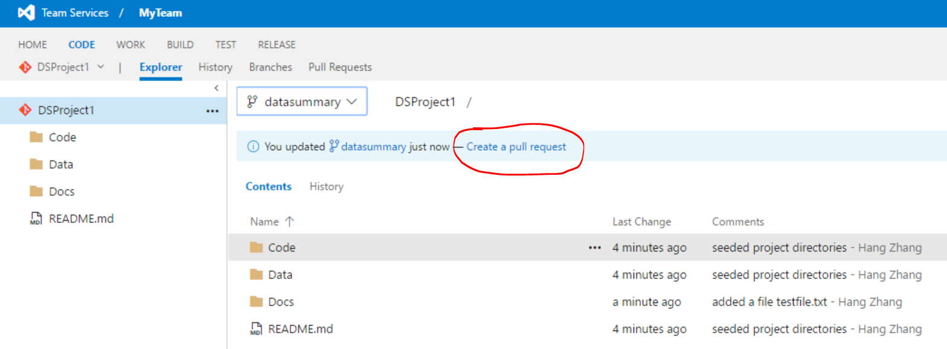
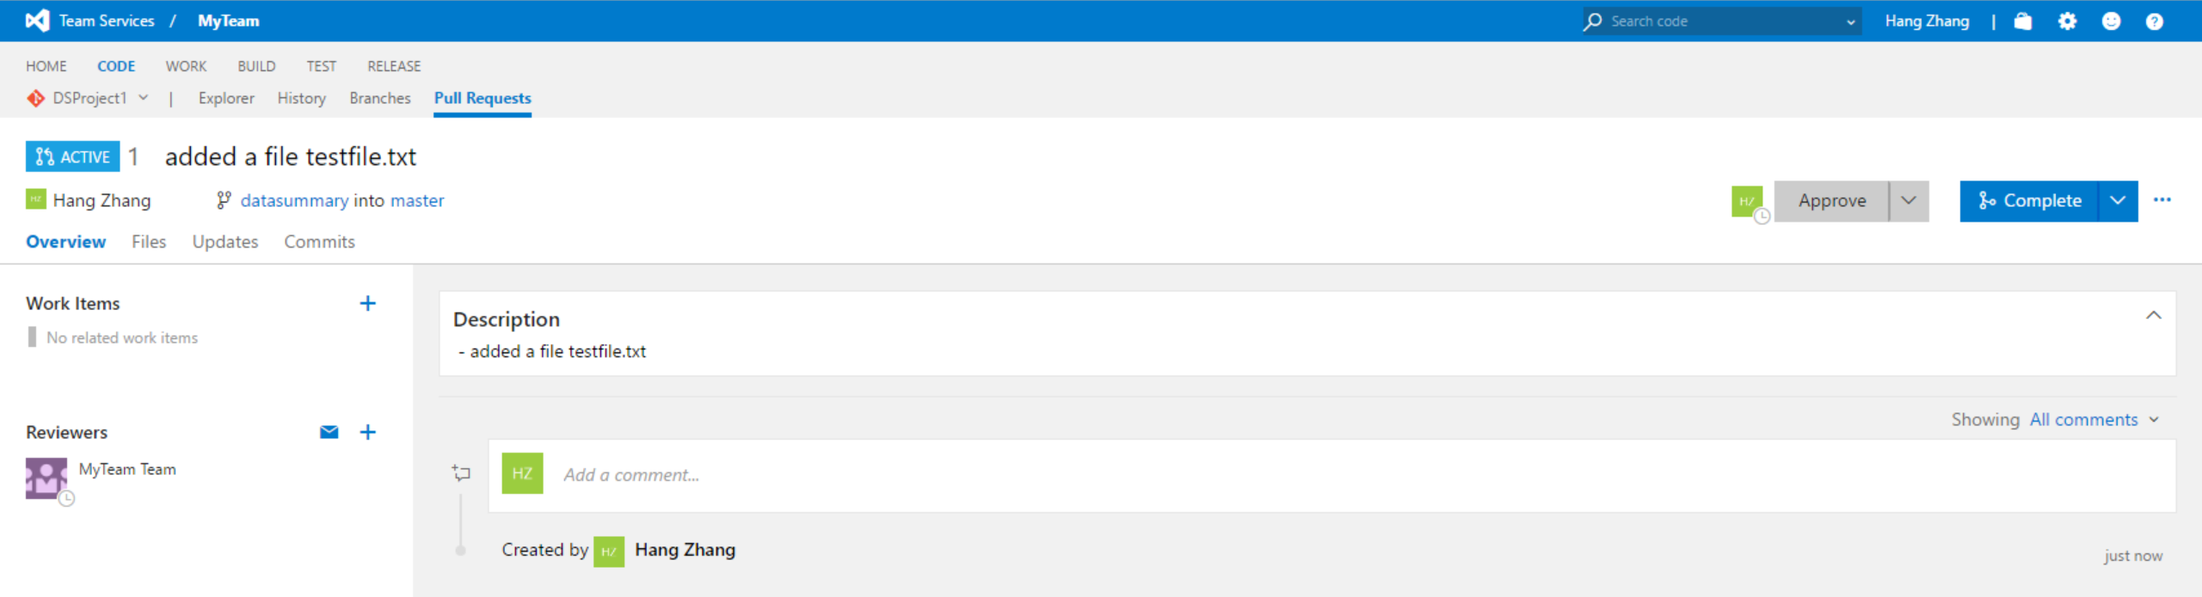
Code review before merging branches to master

Slide 36
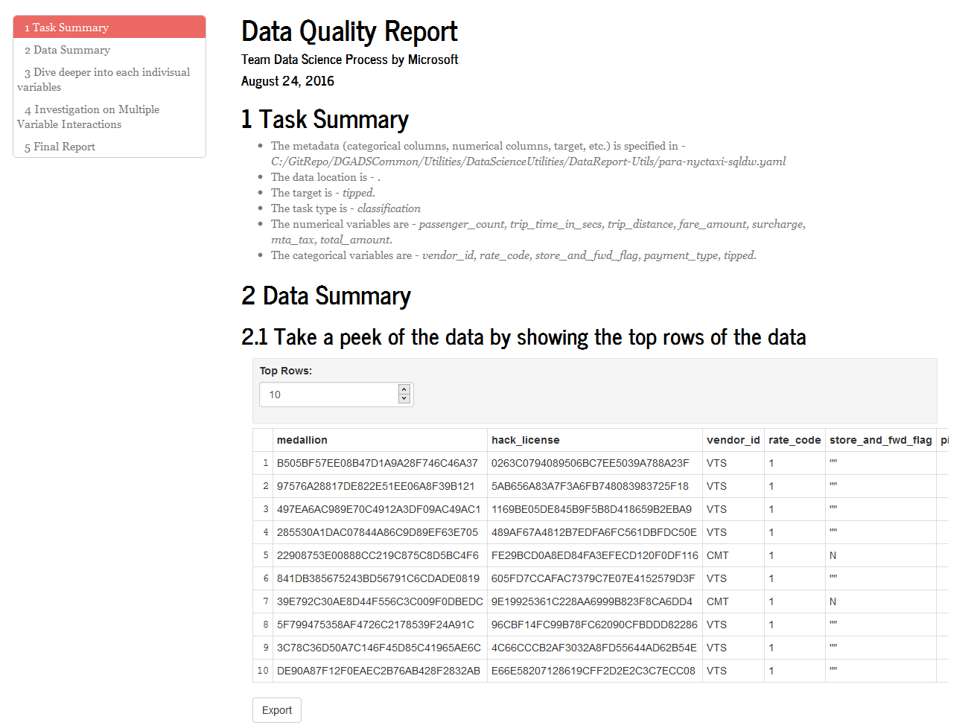
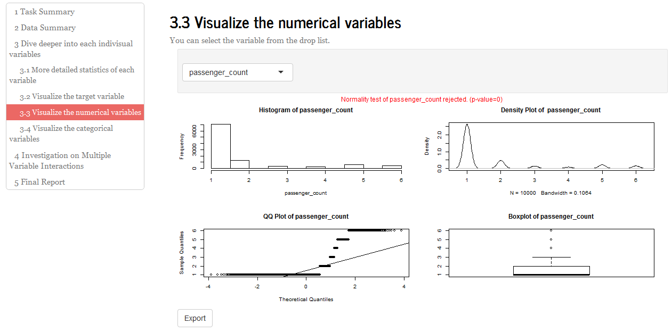
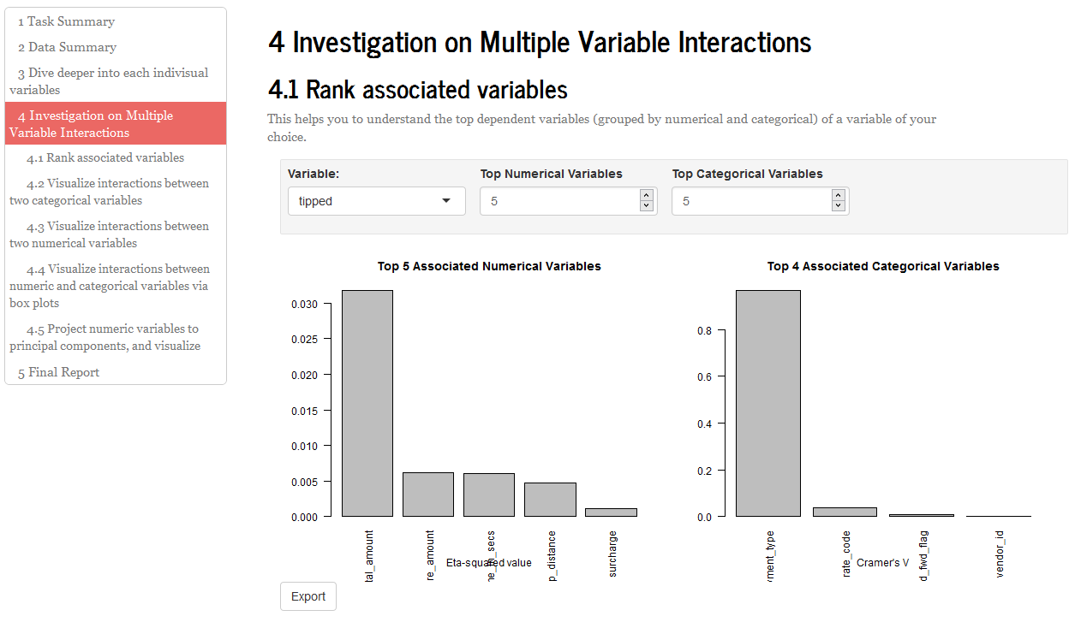
Productivity Tools
Interactive Data Exploration, Analysis, and Reporting (IDEAR)
Shiny-based R Utility
?

Slide 37
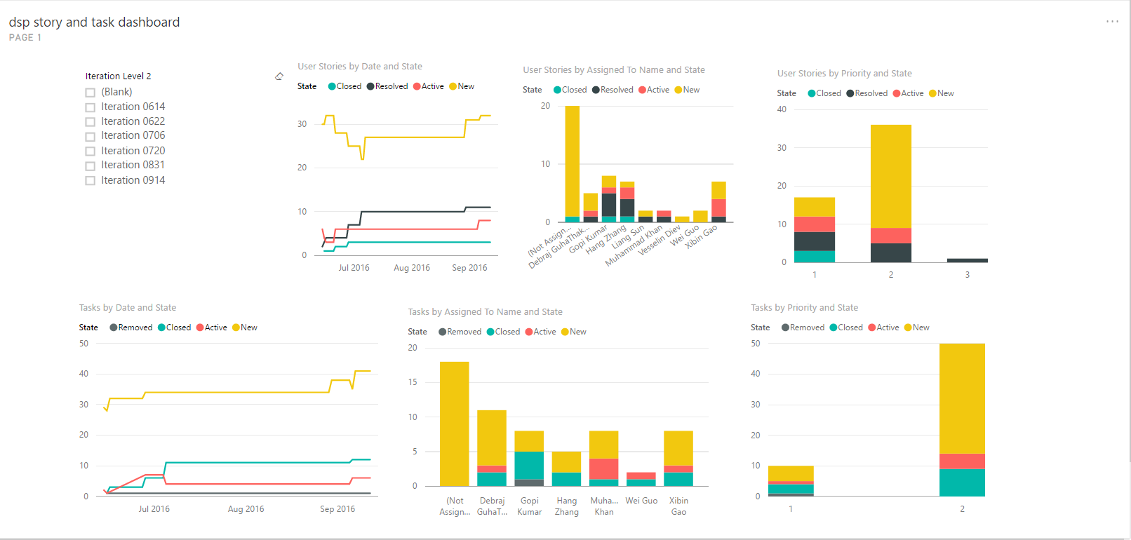
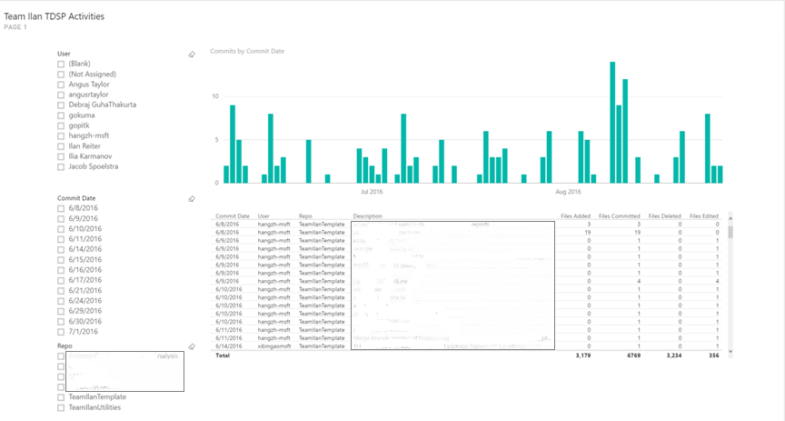
Tracking progress
Making the life of managers easier too with PowerBI reporting

Slide 38
Live demos Show templates (use Charter, Data Definition as examples)
How to link a work item to a git branch in VSTS
IDEAR: Get insights to the data, and generate data summary reports automatically

Slide 39
Next Steps
Find all our assets on Github: https://github.com/Azure/Microsoft-TDSP
Sign up for a free VSTS account: http://www.visualstudio.com
Contribute templates and utilities!

Slide 40
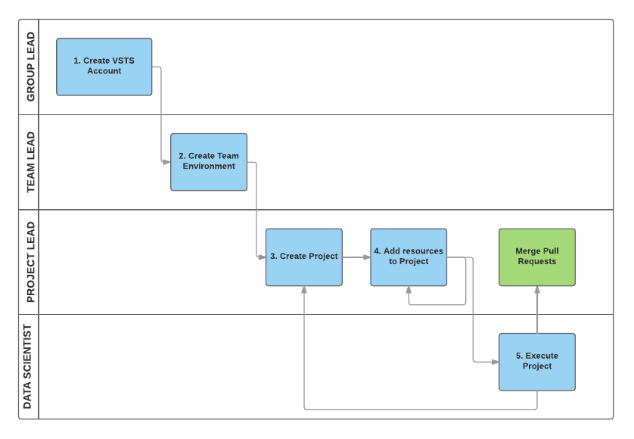
Four roles in TDSP
Keep. Illustrates how a team adapts the process and executes on projects.

Slide 41
Questions?

Slide 42
Challenges at Microsoft
Global teams
Different time zones
New Teams
Different backgrounds
Varied clients
Process has to be flexible, but consistent
Five geographic locations
Both external and internal
How to ensure productivity from day one and consistent work product?
How to effectively collaborate?

Slide 43
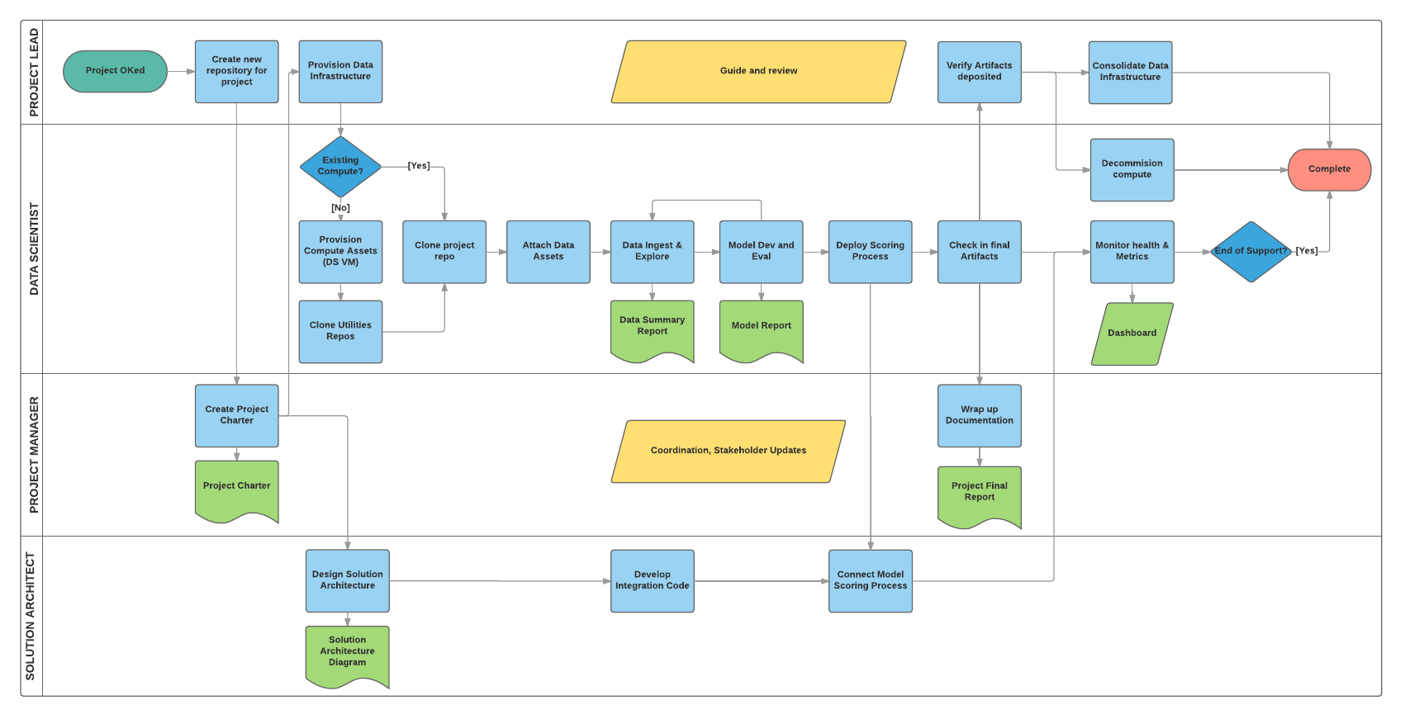
Plan and Prepare Environment
Ingest and explore data, and feature engineering
Train and Retrain Models
Deploy and Consume Models
Post-deployment Activities
Business and Technology Planning

